Slide 1
Genetics Bootcamp: CRISPR screens in mammalian cells
Nolan Maier
Jan 12, 2024

Slide 2
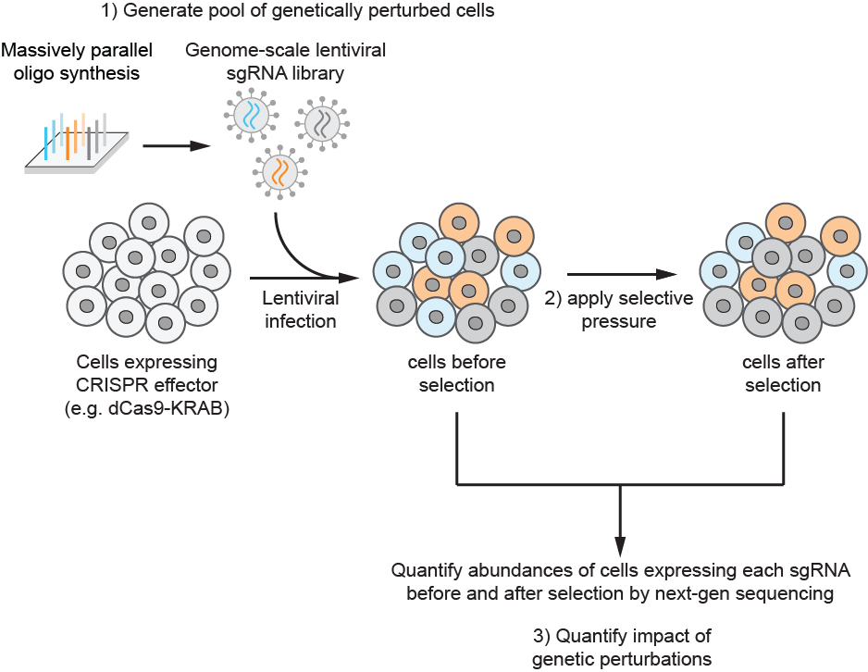
Components of a screen
Cells expressing CRISPR effector
CRISPR cutting, CRISPRi, CRISPRa

Slide 3
Components of a screen
Cells expressing CRISPR effector
sgRNA library

Slide 4
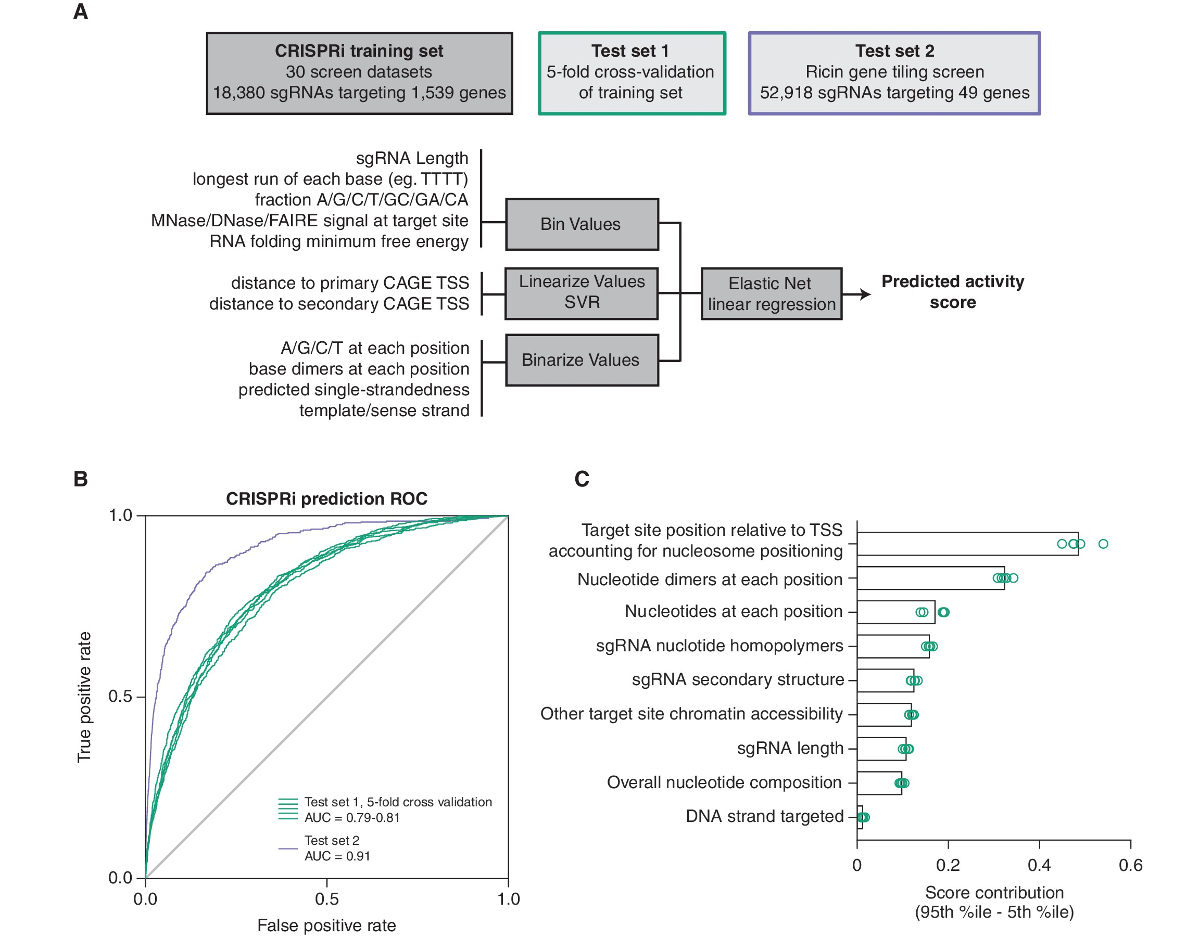
Components of a screen
Finding rules for active sgRNA design is an open-area of research
Data from: Horlbeck et al., eLife 2016 e19760

Slide 5
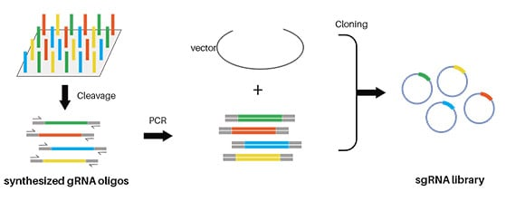
Synthesizing and cloning genome-scale sgRNA libraries is cost-effective

Slide 6

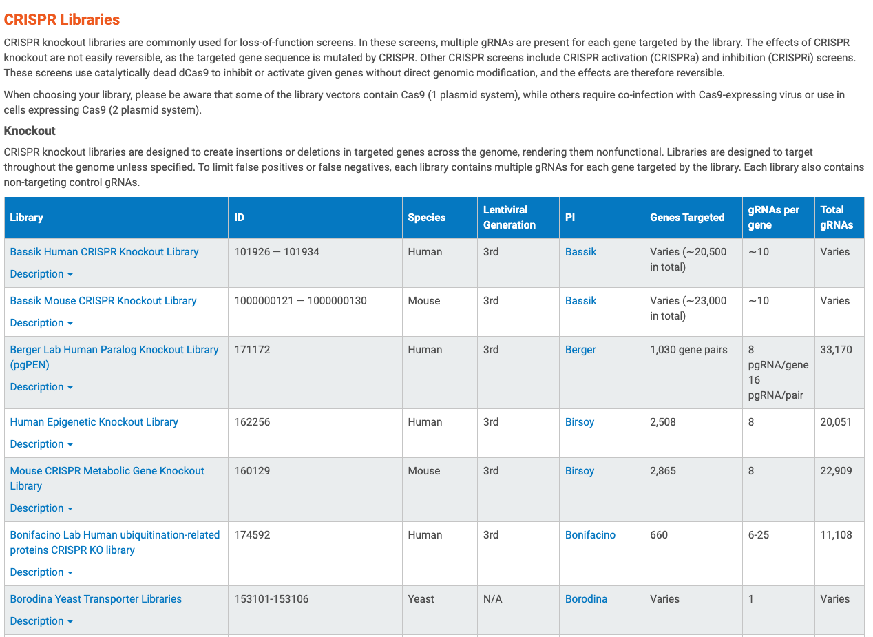
Components of a screen
Libraries exist for many common research organisms

Slide 7
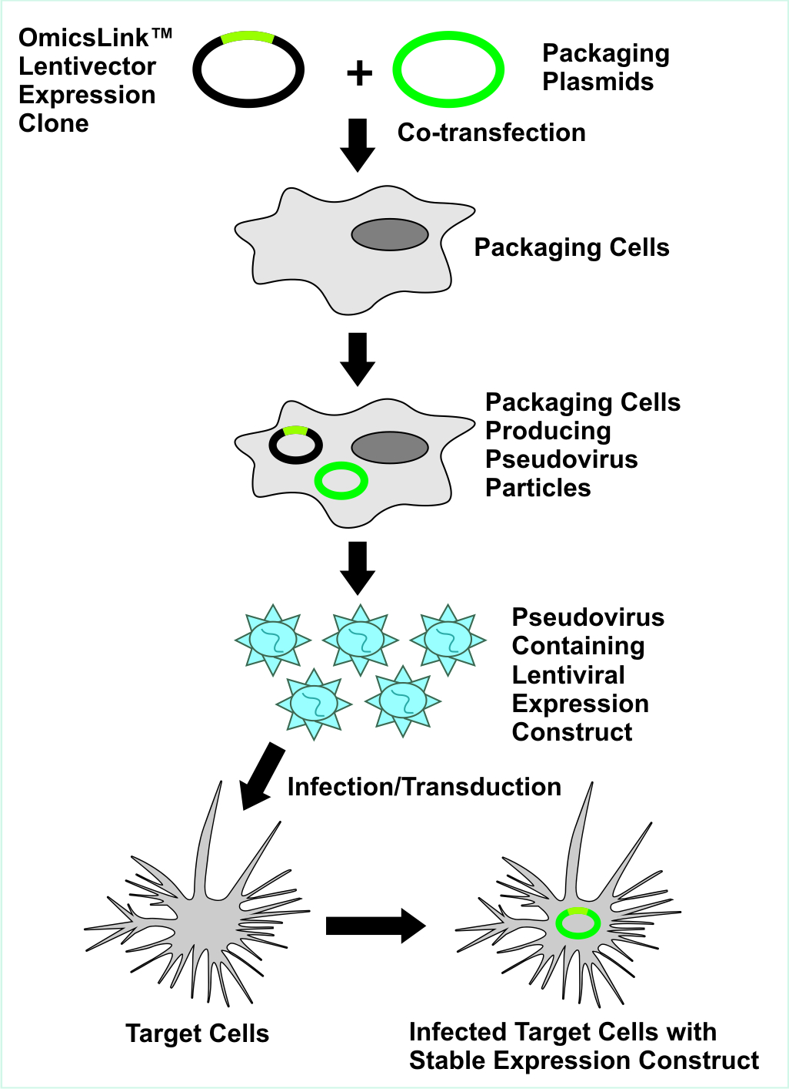
Generating a pool of sgRNA containing lentivirus is relatively straightforward

Slide 8
Genome-wide library or sublibrary?
key consideration is coverage, i.e. how many cells are maintained per sgRNA. We usually aim for 1000x to ensure robust results.
This is a lot!
# genes
20,000
# sgRNAs per gene
10
# cells per sgRNA
1,000
# cells in the screen
200 Million
with improved protocols, we can reduce coverage to 500x in many instances, with minimal decrease in signal
if you can create a list of relevant genes for a question, using sublibraries with sgRNAs targeting only these genes can reduce workload and enable screens of many conditions in parallel

Slide 9
Components of a screen
Cells expressing CRISPR effector
sgRNA library
Selective pressure
Growth? Drug Sensitivity? FACS reporter?

Slide 10
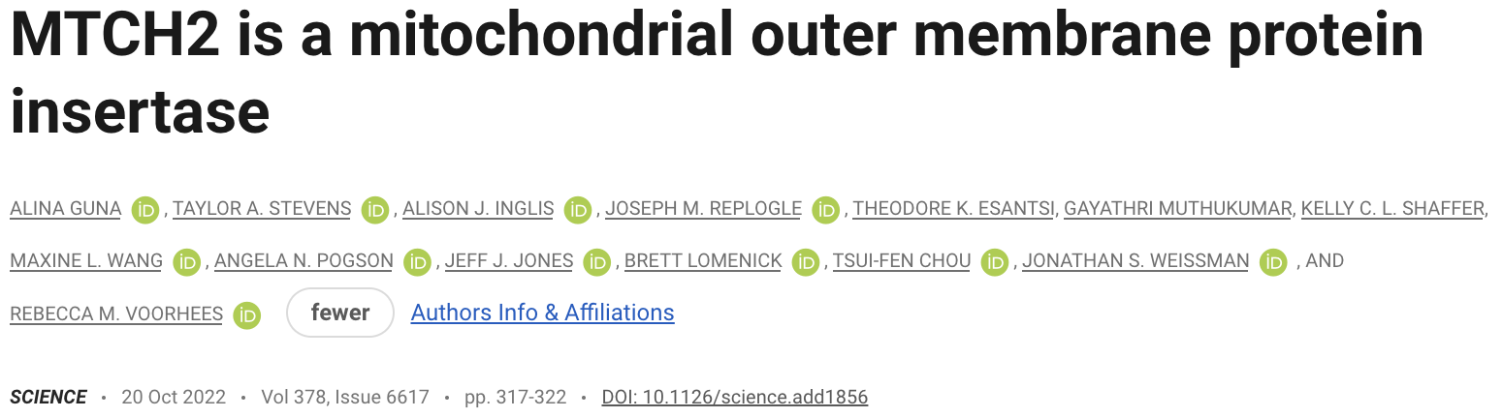

Slide 11
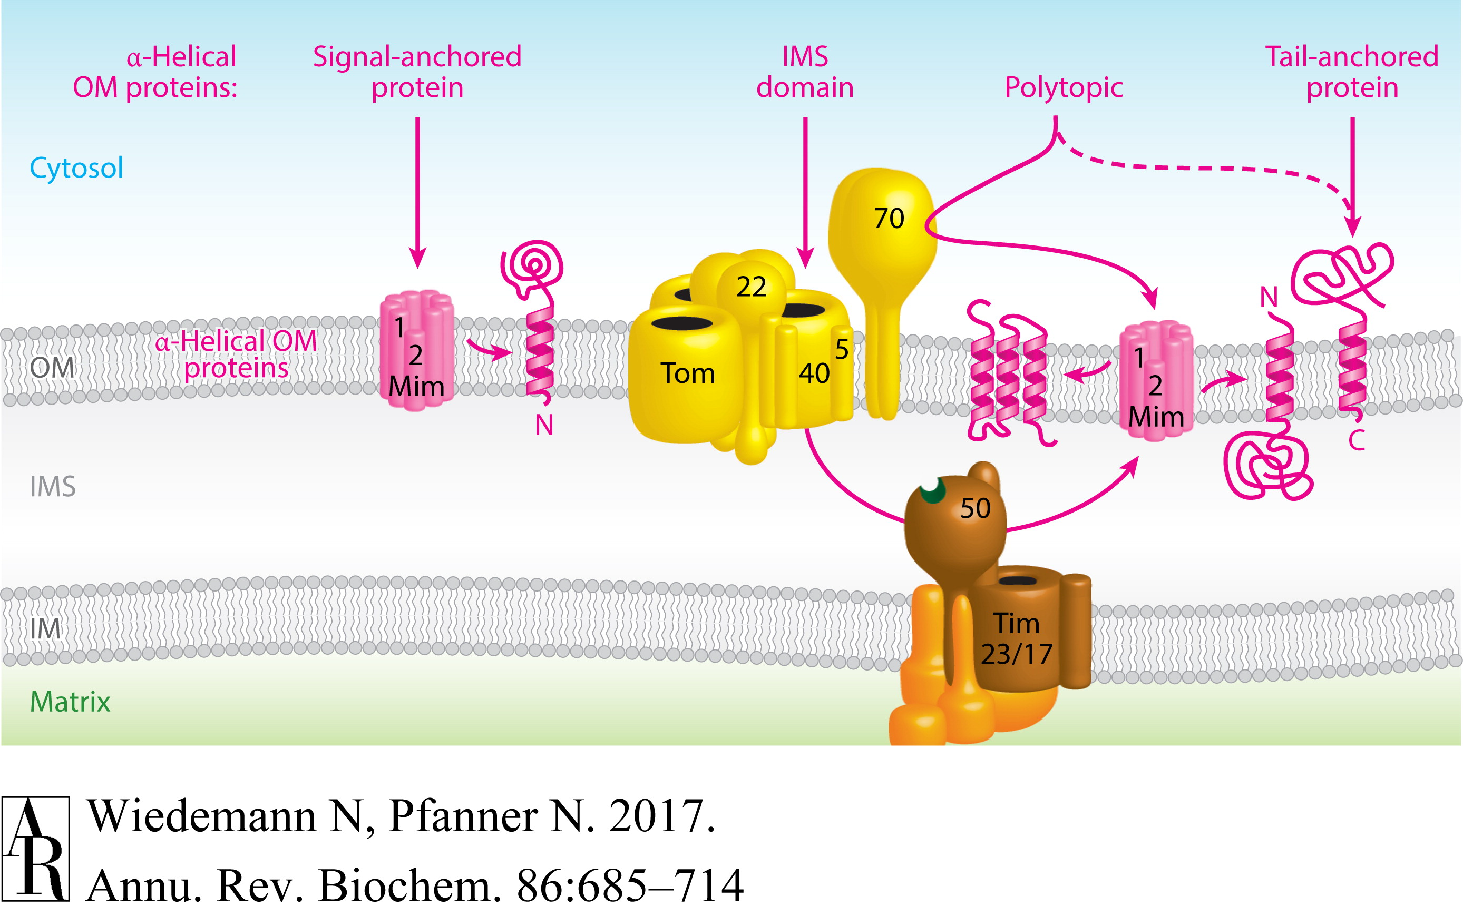
How a-helical proteins are inserted into the outer mitochondrial membrane is not well understood

Slide 12
What is the major question this paper wants to answer?
“We set out to systematically identify and characterize the factors required for mitochondrial TA biogenesis in human cells.”

Slide 13
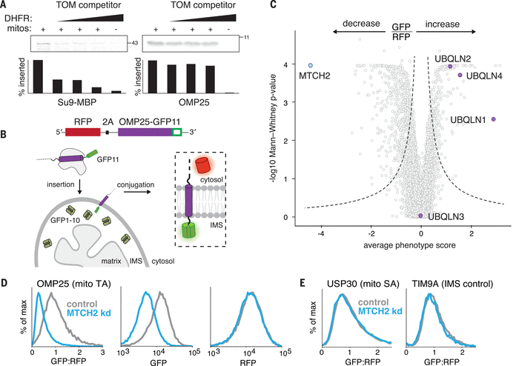
What are the advantages/disadvantages of this reporter design?
Advantages
- Dual fluorescence enables normalization for protein translation
- split-GFP ensures signal only occurs when OMP25 is properly inserted
- 2A and GFP11 are small tags with reduced chance of affecting OMP25 localization
Disadvantages
- Split-system requires multiple rounds of genetic engineering
Figure 1

Slide 14
What controls are important to perform before screening?
The GFP signal must be as specific as possible!
Figure 1

Slide 15
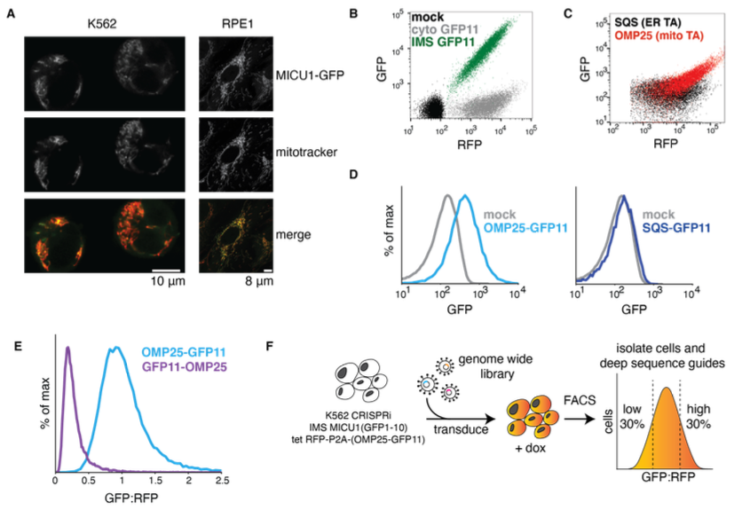
The GFP signal must be specific
GFP1-10 is correctly localized to the mitochondria
No GFP signal from cytosolic or ER localized GFP11
GFP signal only when GFP11 is on the correct side of the outer membrane
Figure S3

Slide 16
Screen design
Figure S3

Slide 17
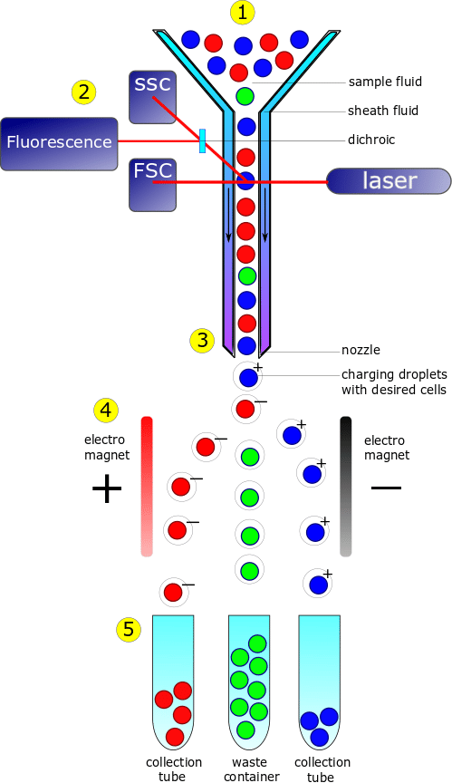
Fluorescence-activated cell sorting (FACS) allows rapid sorting of cells based on fluorescence signal

Slide 18
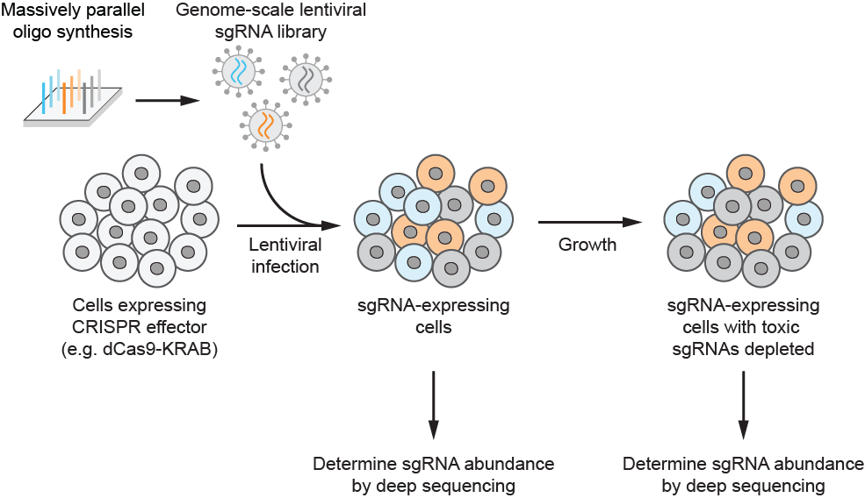
Library prep
Extract genomic DNA
U6 promoter
sgRNA
constant region
other vector elements
U6 promoter
sgRNA
constant region
other vector elements
U6 promoter
sgRNA
constant region
other vector elements
PCR amplify sgRNA cassettes and
append Illumina adapters
Illumina sequencing
(depth = ~0.7-1x screen coverage)
Critical: genomic DNA extraction and PCR need to be efficient to maintain representation

Slide 19
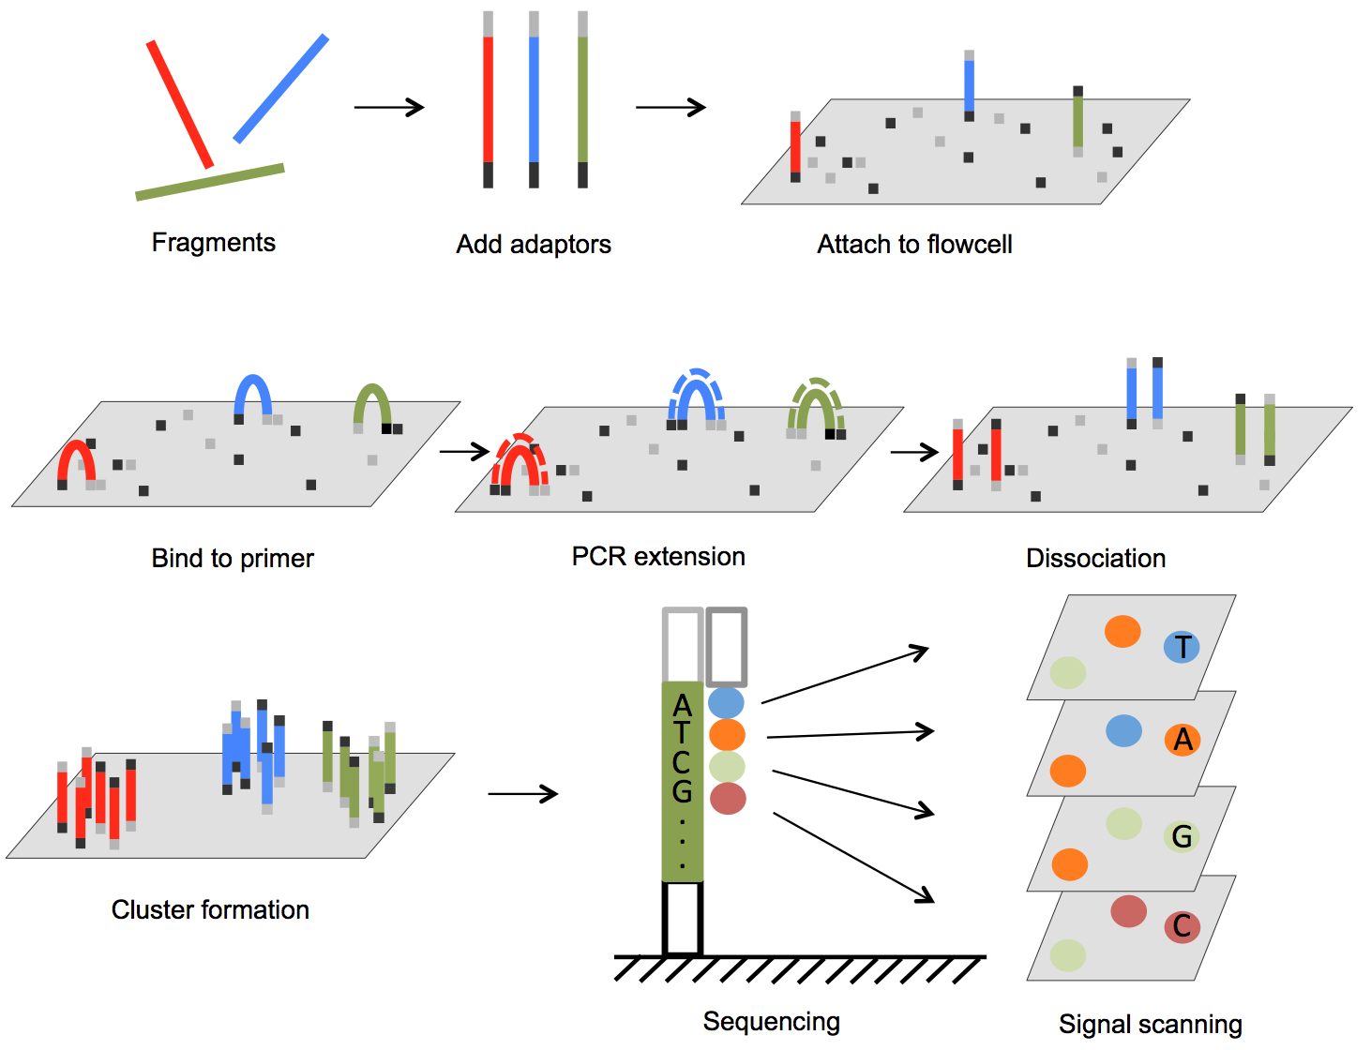
Illumina Sequencing Technology

Slide 20
Data Processing
Sample data can be found at:
github.com/nolanmaier/2024_GeneticsBootcamp

Slide 21
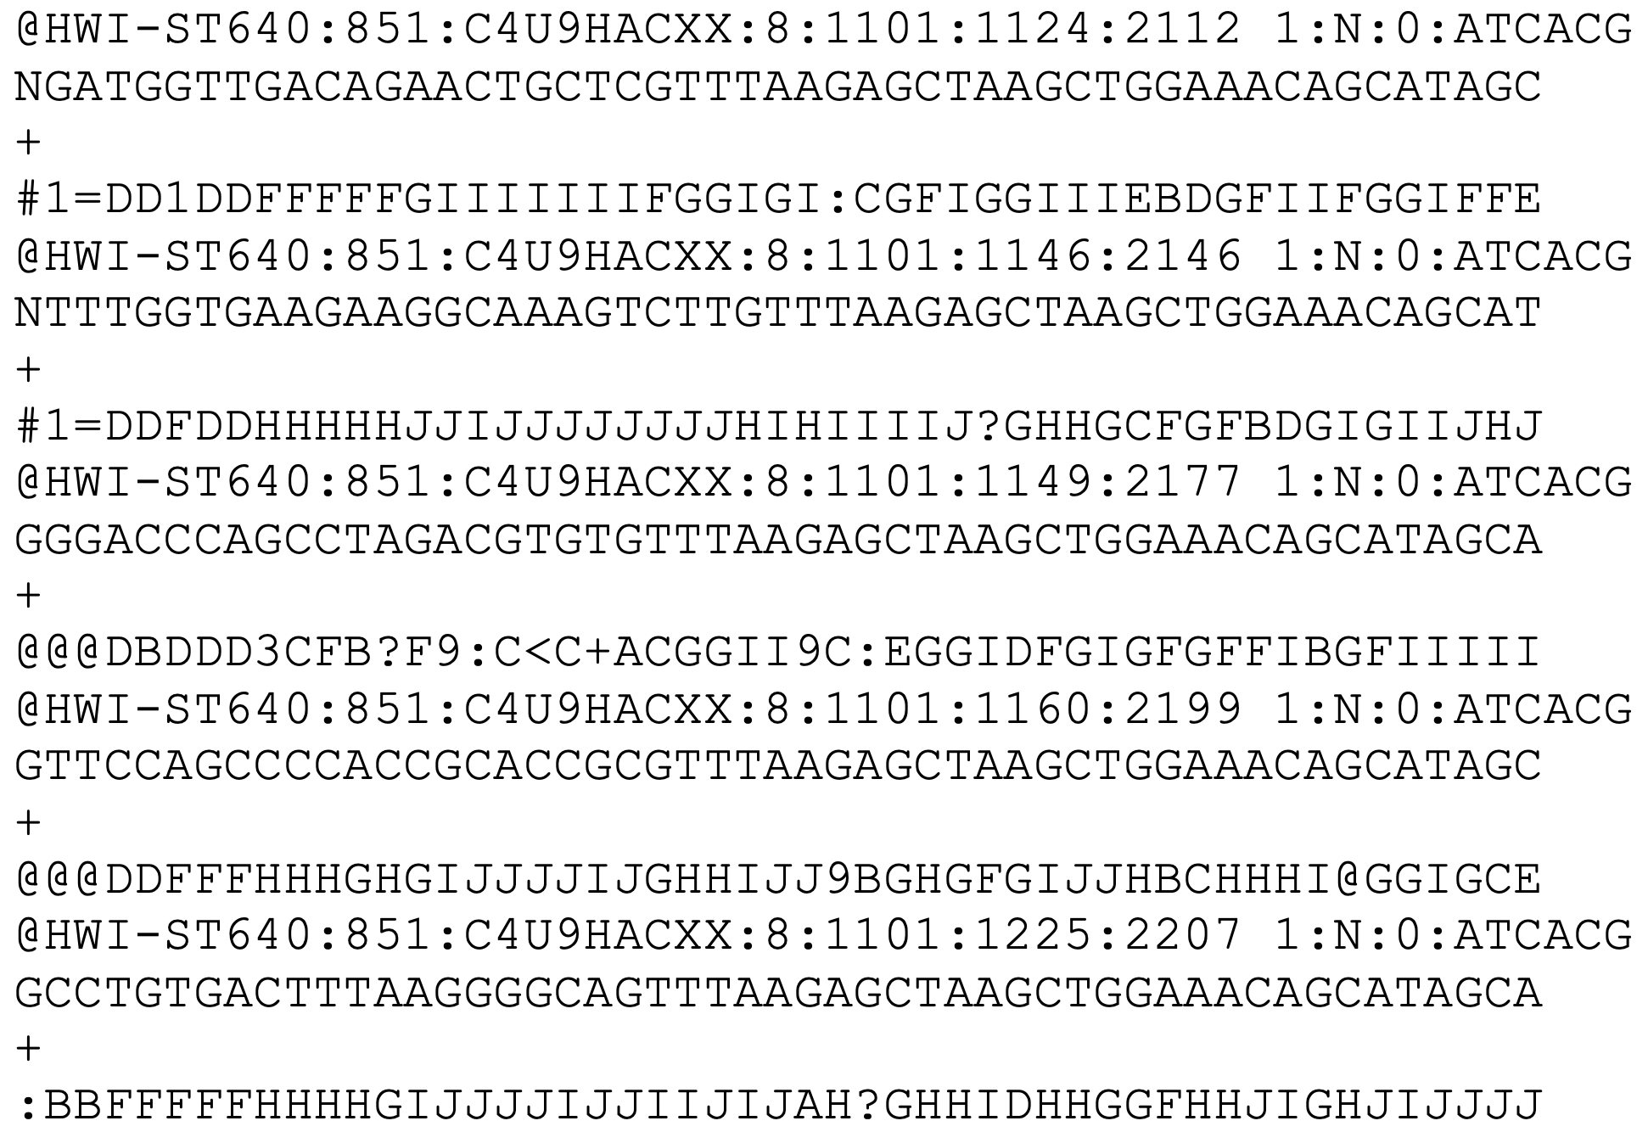
Data Processing Step 1: Convert sequence data to sgRNA counts
Open sample_illumina_data.fastq using a text editor
One entry = one read = one molecule in library
Line 1: sequence id
Line 2: base calls
Line 3: separator
Line 4: quality scores

Slide 22
Data Processing Step 1: Convert sequence data to sgRNA counts
Sequence id
Contents vary by sequencer and software
Usually contains information about the instrument, flow cell, cluster location, and demultiplexing information
Example format for Illumina sequencers
@<instrument>:<run number>:<flowcell ID>:<lane>:<tile>:<x-pos>:<y-pos>:<UMI> <read>:<is filtered>:<control number>:<index>

Slide 23
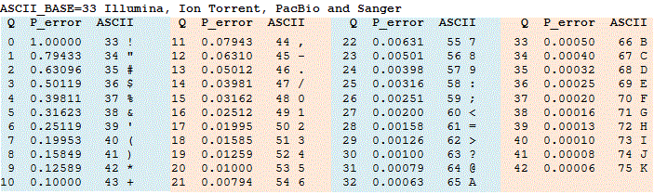
Data Processing Step 1: Convert sequence data to sgRNA counts
Quality scores
ASCII encoded
estimated probability of error

Slide 24
Data Processing Step 1: Convert sequence data to sgRNA counts
U6 promoter
sgRNA
constant region
other vector elements
All sgRNA sequences in sample are known
Use lookup table to find the matching sgRNA ID and gene

Slide 25
Data Processing Step 1: Convert sequence data to sgRNA counts
Try it yourself!
What sgRNAs do the first 5 reads in the FastQ file correspond to?
Use hCRISPRiv2_sgRNA_list.xlsx as your lookup table

Slide 26
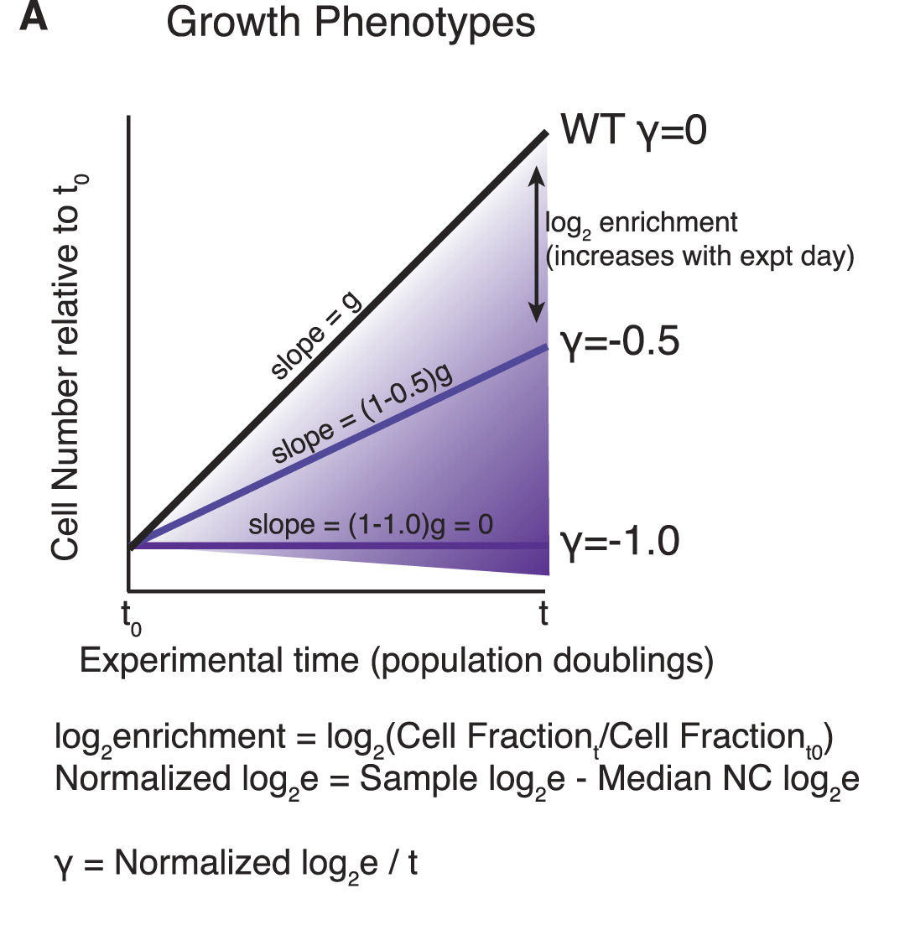
Data Processing Step 2: Calculate sgRNA and gene level phenotypes
sgRNA phenotype score
counts endpoint
sgRNA phenotype = log₂( )
counts start

Slide 27
Data Processing Step 2: Calculate sgRNA and gene level phenotypes
sgRNA phenotype score
counts endpoint
sgRNA phenotype = log₂( )
counts start
Try it yourself!
What are the phenotype scores of the three sgRNAs below?
start
endpoint
sgGeneA GGGCGGCTAGAAGGTGACCG 500
sgGeneB GCTGTCCAGGAGGGGCGTGT 750
sgGeneC GTGCACACGGCAGTAGAAAA 800
sgGeneA GGGCGGCTAGAAGGTGACCG 100
sgGeneB GCTGTCCAGGAGGGGCGTGT 750
sgGeneC GTGCACACGGCAGTAGAAAA 900

Slide 28
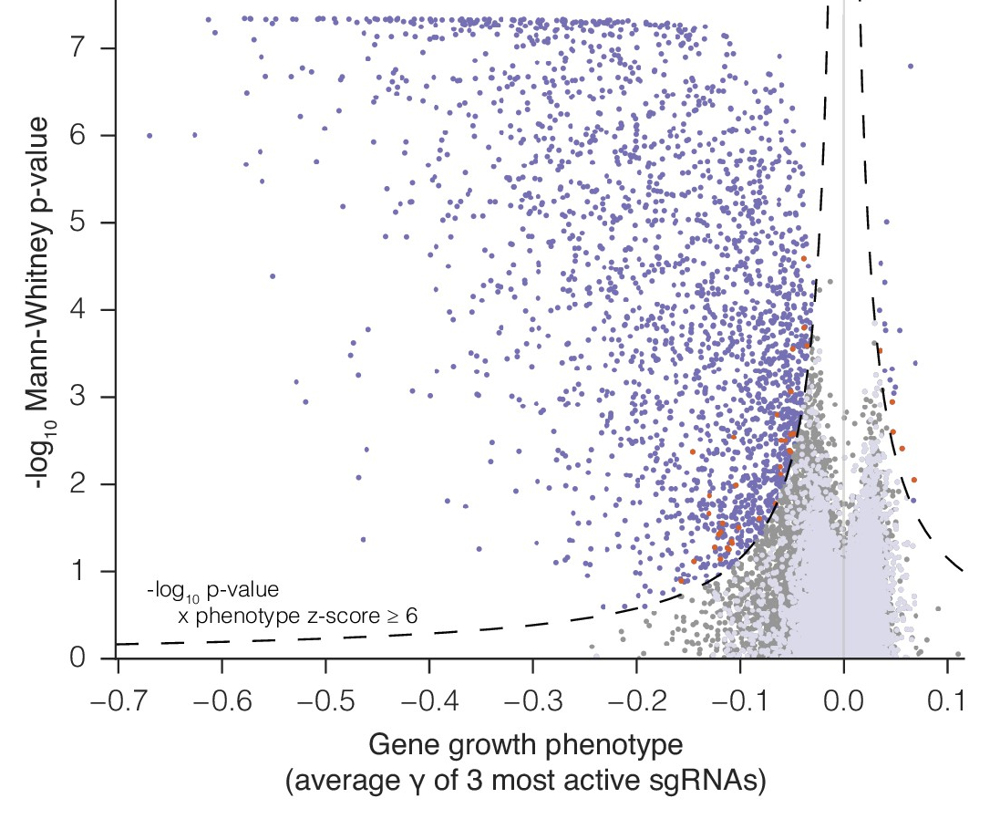
Data Processing Step 2: Calculate sgRNA and gene level phenotypes
gene phenotype score = average of 3 strongest sgRNAs
Mann-Whitney p-value = comparison of gene-specific sgRNA phenotype
vs non-targeting control sgRNA

Slide 29
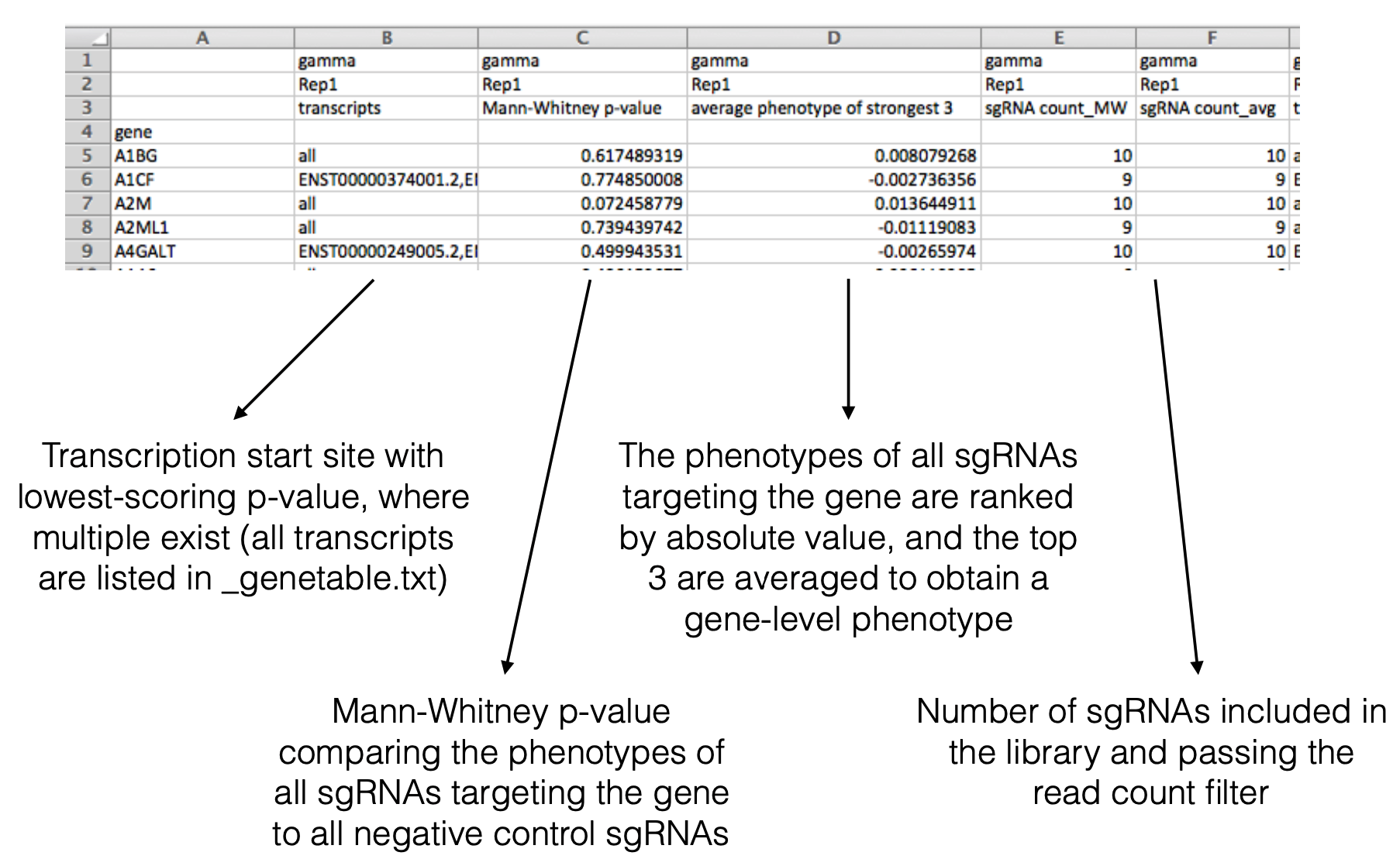
Data Processing Step 2: Calculate sgRNA and gene level phenotypes
Open screendata_growth.csv

Slide 30
Data Processing
No one actually does this by hand.
Many automated scripts exist for processing sgRNA count data.
Example python scripts can be found at:
github.com/mhorlbeck/ScreenProcessing

Slide 31
“We set out to systematically identify and characterize the factors required for mitochondrial TA biogenesis in human cells.”

Slide 32
Volcano plots are helpful for visualizing hits
- Knockdown of ubiquilin chaperones increases GFP signal
- Ubiquilins are known to degrade TA proteins
- Knockdown of MTCH2 decreases GFP signal
- MTCH2 is an outer mitochondrial membrane protein annotated as a transporter of metabolites into the mitochondria, but has no known substrate
Figure 1

Slide 33
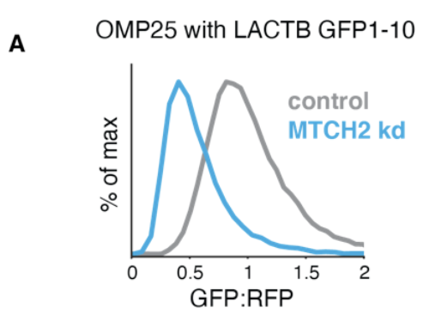
Transducing individual sgRNAs for validation
Validating that knockdown of MTCH2 increases GFP signal
Knockdown of MTCH2 has no effect on global translation
Figure 1
Validating that knockdown of MTCH2 increases GFP signal with an alternative reporter
Figure S6

Slide 34
Conclusion: MTCH2 plays a role in biogenesis of OMP25
Question: What role does MTCH2 play in general mitochondrial protein biogenesis?

Slide 35
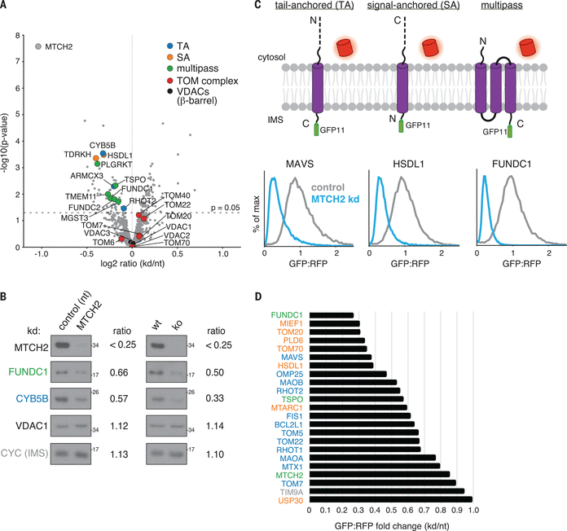
Mass-spectrometry reveals the extent of MTCH2’s effect on mitochondrial outer membrane protein biogenesis
Figure 2

Slide 36
MTCH2 affects the biogenesis of a-helical mitochondrial membrane proteins generally
Figure 2

Slide 37
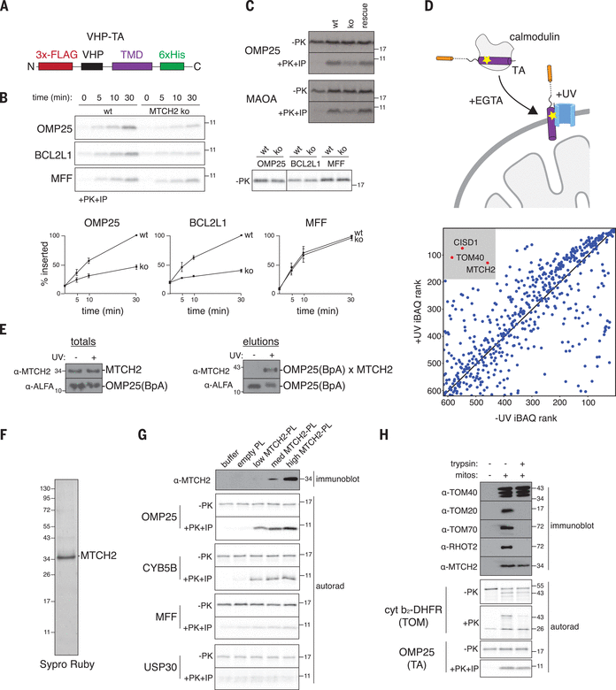
MTCH2 binds and inserts a-helical proteins into membranes in vitro
Figure 3

Slide 38
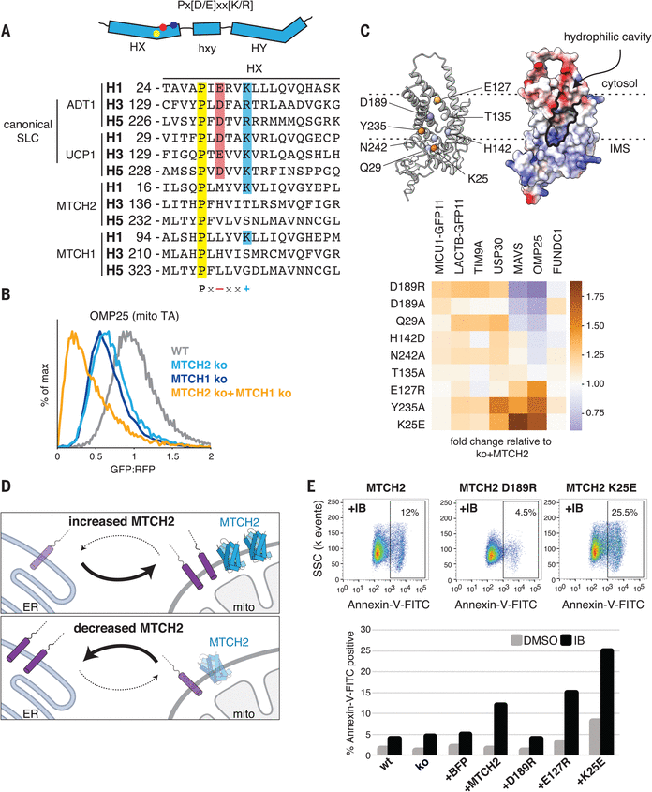
MTCH2 regulates outer membrane function
MTCH2 is the founding member of a novel class of membrane protein insertases
Figure 4

Slide 39
What can we take away about screen design?
Carefully design your selective pressure to answer your biological question
Genome-wide screens are a lot of work with mammal-sized genomes
The screen is only the beginning
Independent hit validation is important
Going from gene hit to cellular function can be a long road

Slide 40
Now let’s analyze a CRISPR screen ourselves!

Slide 41
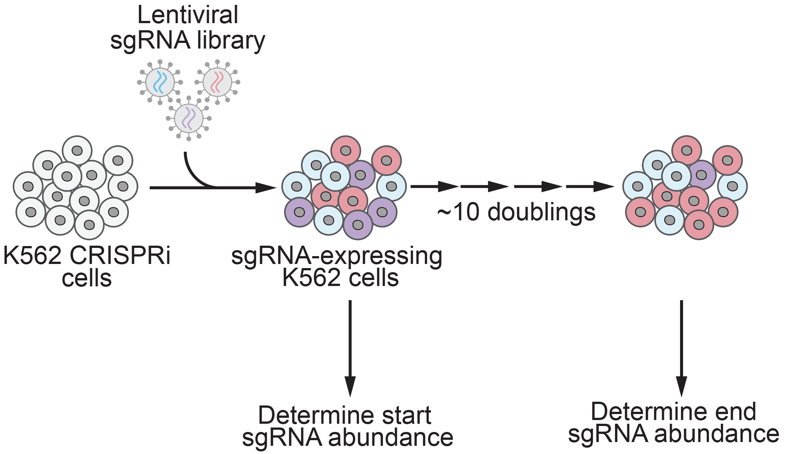
Data Exploration Part 1: Growth screen
Data from: Horlbeck et al., eLife 2016 e19760

Slide 42
Data Exploration Part 1: Growth screen
Try it yourself!
Open the CRISPR_screen_analysis.ipynb Jupyter notebook
There is a Google Colab link at the bottom of the Github repo:
github.com/nolanmaier/2024_GeneticsBootcamp

Slide 43
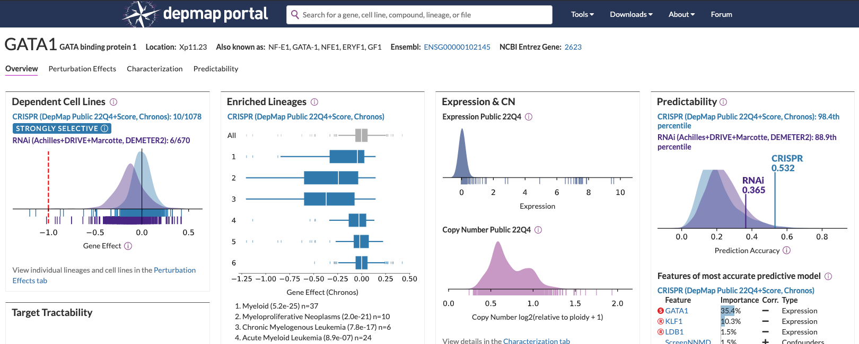
Data Exploration Part 1: Growth screen
Main Takeaways:
Essential genes (e.g. ribosomes) are major hits in growth screens
Comparing essential genes across cell lines can reveal cell-type specific essential genes

Slide 44
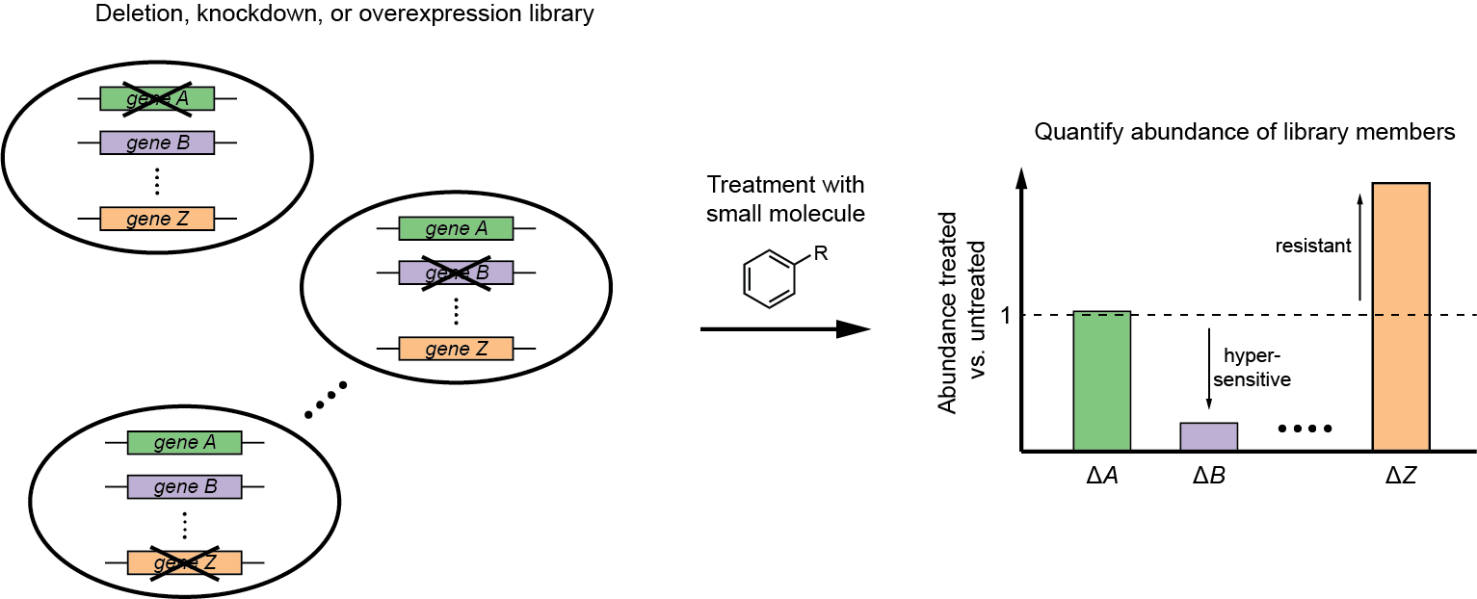
Data Exploration Part 2: Chemical-genetic screen
Chemical-genetic screening = systematic measurements of drug sensitivity of strains with perturbed gene expression (e.g. deletion or overexpression)
putative target
Giaever et al., Nat. Genet. 1999, 21, 647; Lum et al., Cell 2004, 116, 121; and more

Slide 45
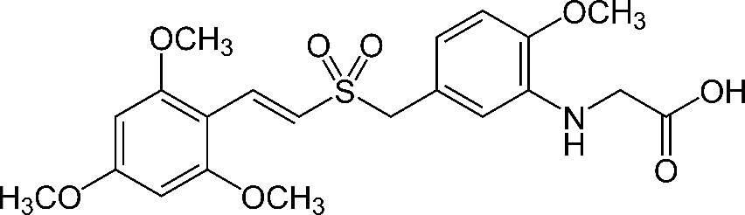
Data Exploration Part 2: Chemical-genetic screen
Rigosertib
(Estybon,
ON 01910.Na)
first reported in 2005, kills many types of cancer cell lines
causes G2/M arrest, apoptosis
was in phase III clinical trials for myelodysplastic syndrome and other cancers
but molecular target and mechanism of action unclear
proposed to inhibit polo-like kinase 1 (PLK1), PI3 kinase, or Ras signaling, but claims are controversial
Gumireddy et al., Cancer Cell 2005, 7, 275; Athuluri-Divakar et al., Cell 2016, 165, 643

Slide 46
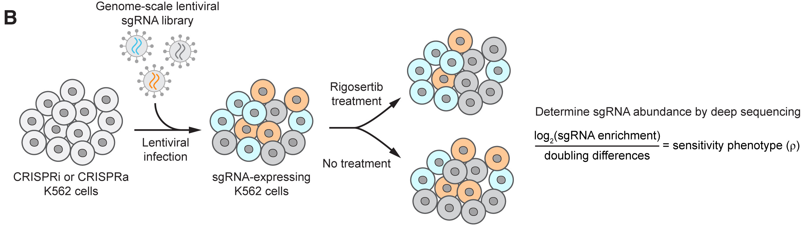
Data Exploration Part 2: Chemical-genetic screen

Slide 47
Data Exploration Part 2: Chemical-genetic screen
Try it yourself!
Open the CRISPR_screen_analysis.ipynb Jupyter notebook
There is a Google Colab link at the bottom of the Github repo:
github.com/nolanmaier/2024_GeneticsBootcamp

Slide 48
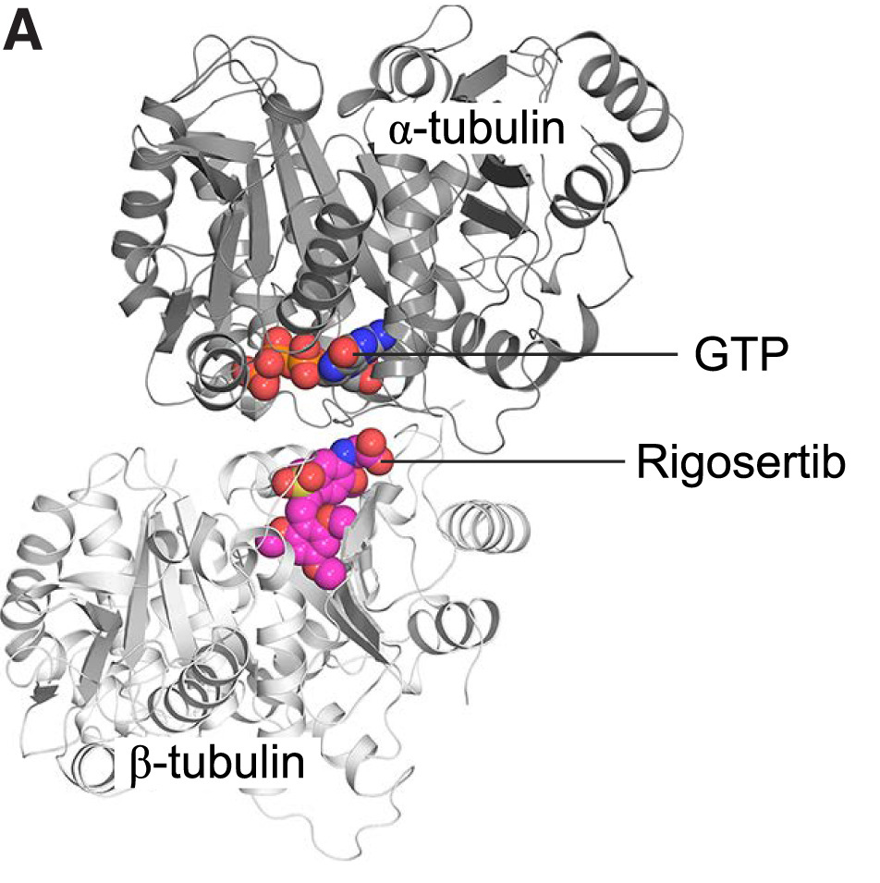
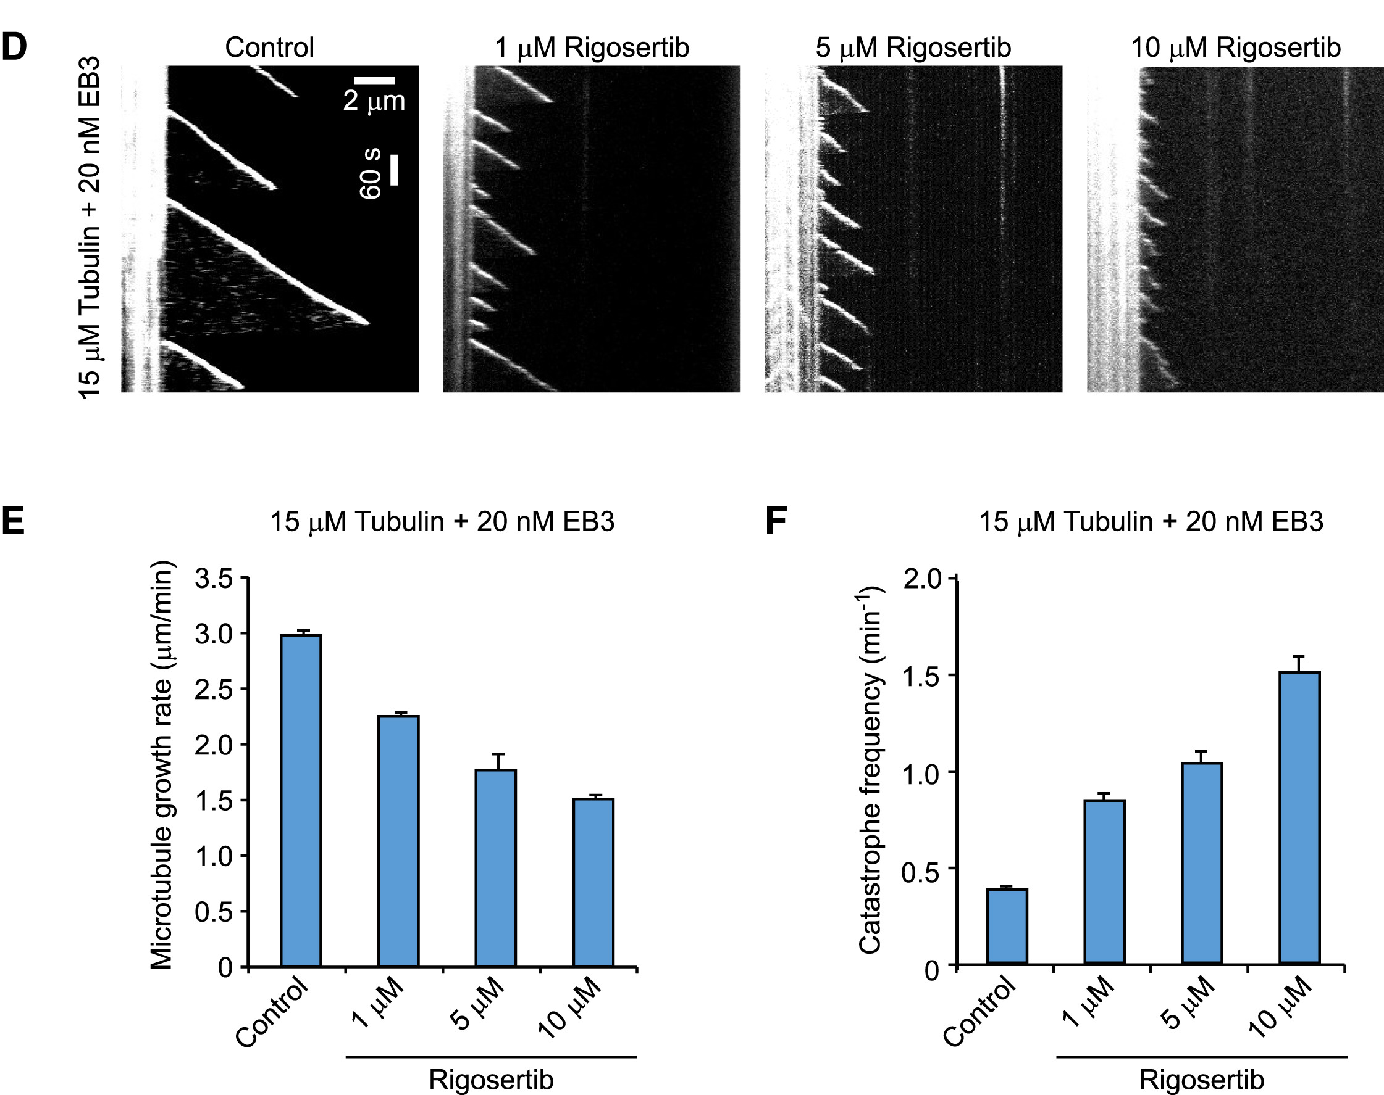
Validation: Rigosertib binds tubulin and affects microtubule dynamics
Data Exploration Part 2: Chemical-genetic screen
Data from: Jost & Chen et al., Molecular Cell 2017 68:1

Slide 49
Data Exploration Part 2: Chemical-genetic screen
Main Takeaways:
Genetic screens are hypothesis generators
Layering data from multiple screens can narrow down hypotheses
Validation is always necessary to address a particular hypothesis

